Slide 1
VDC Provider COVID-19 Listening Session
March 26, 2020

Slide 2
Agenda
Welcome
Goals of the Session
COVID-19 Resources from ACL and VA
Announcements from VHA Regarding VDC
What’s Happening on the Ground?
Menti Questions
Closing
Notes:
Hear from ACL and VHA regarding COVID-19 updates in regards to VDC providers
Hear from VDC providers regarding challenges, concerns, planning activities etc. regarding the COVID-19 pandemic
Answer questions

Slide 3
COVID-19 Resources
The federal government response: www.coronavirus.gov/
The actions of the U.S. Department of Veterans Affairs (VA): https://www.publichealth.va.gov/n-coronavirus/
The Department of Health and Human Services (HHS) Administration of Community Living (ACL) assistance: https://acl.gov/COVID-19
The HHS Office for Civil Rights (OCR) guidance on telehealth: https://www.hhs.gov/about/news/2020/03/20/ocr-issues-guidance-on-telehealth-remote-communications-following-its-notification-of-enforcement-discretion.html
The Department of Defense Military OneSource: https://www.militaryonesource.mil/coronavirus
The CMS Blanket Waivers and Telehealth Actions: https://www.cms.gov/files/document/covid19-emergency-declaration-health-care-providers-fact-sheet.pdf

Slide 4
Announcements from VHA regarding VDC
Daniel Schoeps, Director, VA Purchased Long-Term Services and Supports

Slide 5
What’s Happening On The Ground?
Options for sharing information and asking questions:
Use the raise your hand function and we will unmute your line.
Use the chat feature in the right side panel of the WebEx platform to enter your questions and send to “all participants.”

Slide 6
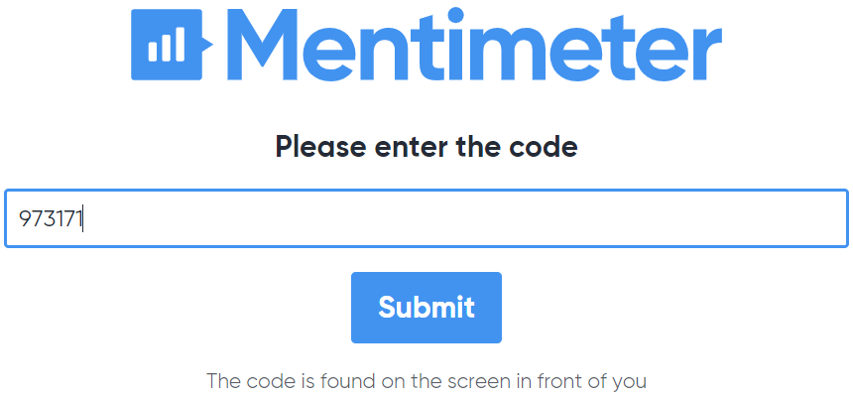
Mentimeter Survey
Go to menti.com and enter code: 97 31 71
Notes:
1. Would it be helpful to have regular opportunities to share information on calls (similarly to our listening session today)?
2. If yes, how frequent would you prefer listening sessions to be held?
3. Telehealth is defined as the use of electronic information and telecommunication technologies to support long-distance clinical health care, patient and professional health-related education, public health, and health administration. For VDC providers, does your organization have the capacity to use telehealth to conduct assessments and monthly check-in visits?
4. Do you have experience using telehealth modalities to conduct assessments?
5. What training would be helpful to be able to conduct telehealth assessments and check-ins?

Slide 7
Closing
Please email the VDC Technical Assistance Team with any questions: veterandirected@acl.hhs.gov
A FAQ will be posted online at: https://nwd.acl.gov/vdc.html

